Slide 1


Slide 2
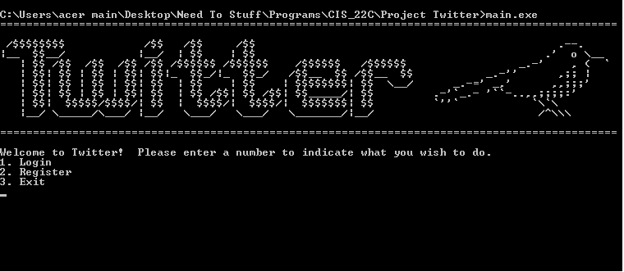
At Least We Have Our Own Logo...

Slide 3
Features
2A. Add tweet
2B. View Newsfeed
2C. View Profile
2D. Display all users
2E. Follow users
2F. Deleting Profile
2C. Profile Settings Options
i. View my tweets
ii. Delete a tweet
iii. View my followers
iv. View who I’m following
v. Unfollow
Create new user
Login
Show Users in BST
Show Efficiency
Writing keys to a file

Slide 4
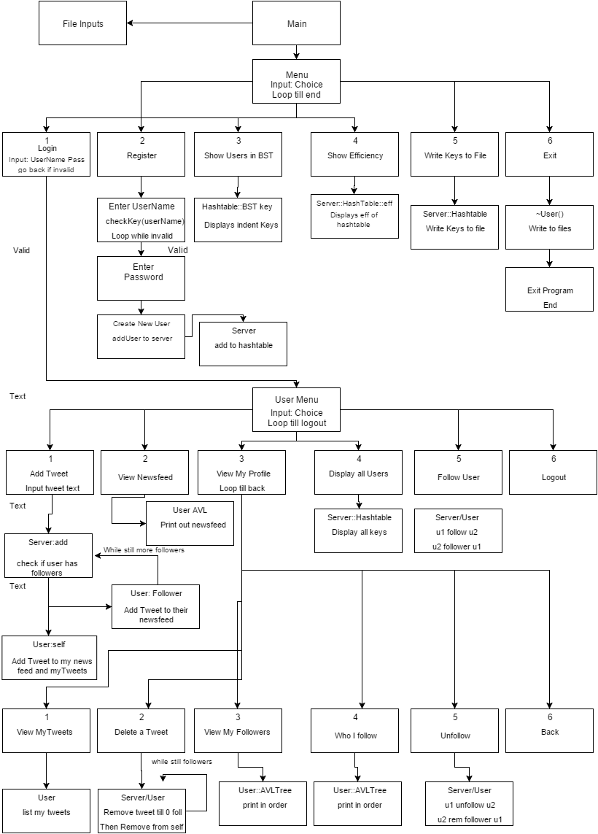
Flow Chart
More diagrams? UML????

Slide 5
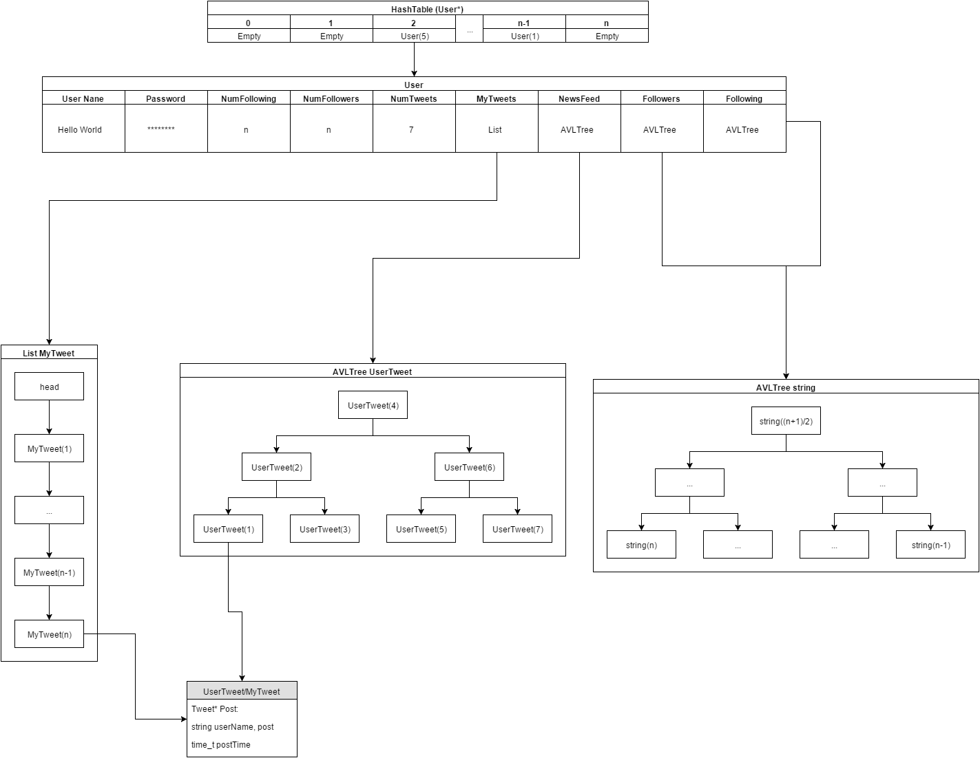
Data Diagram
There’s a bunch of slides with diagrams and shit????? data structure???

Slide 6
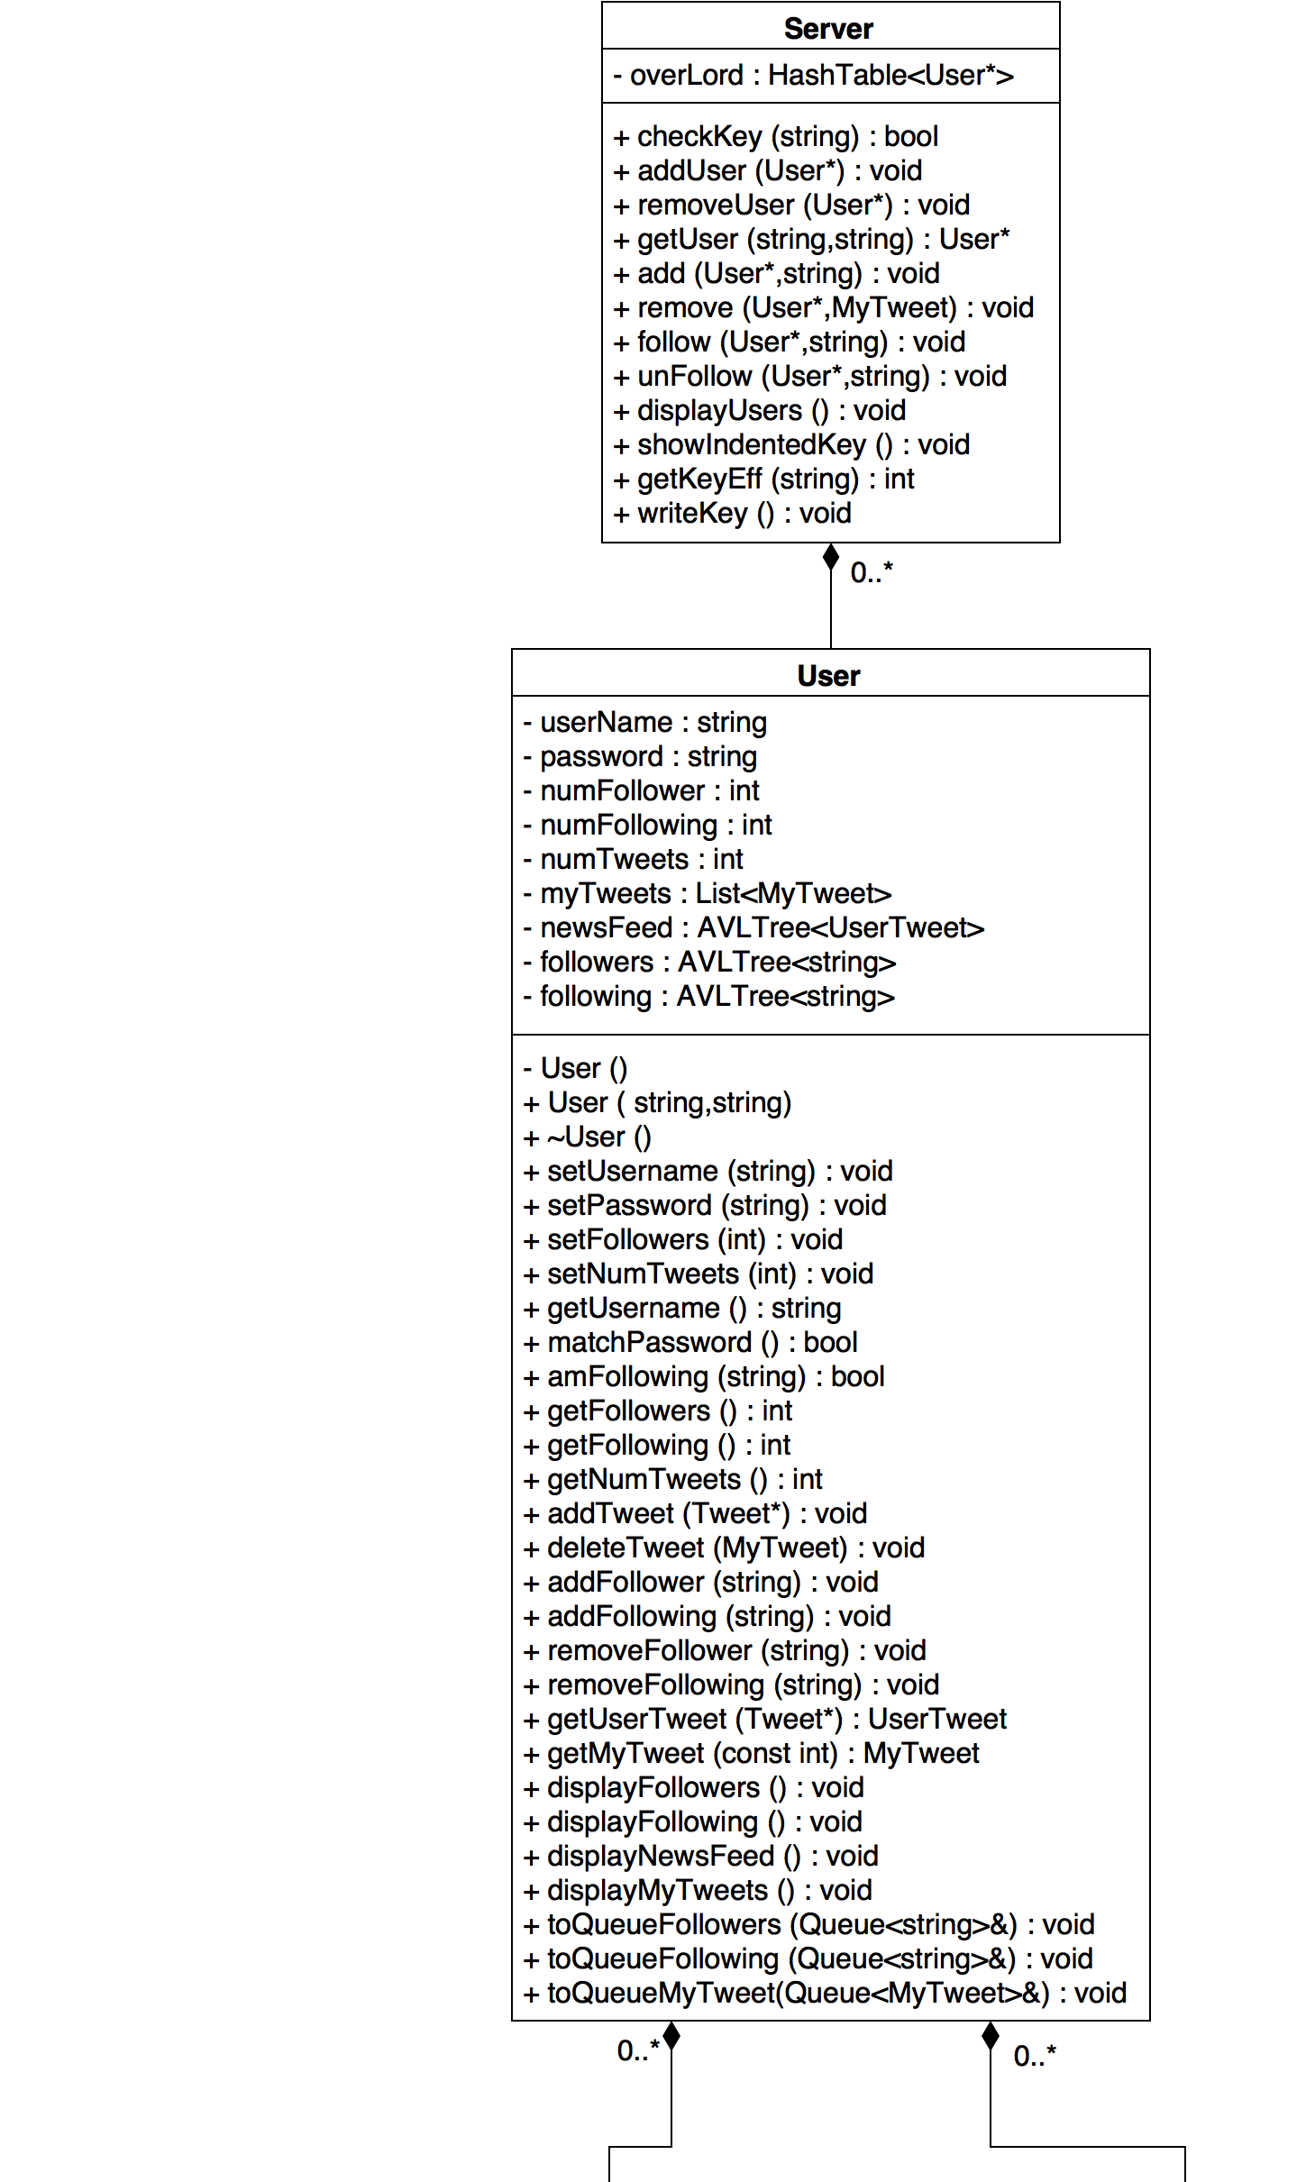
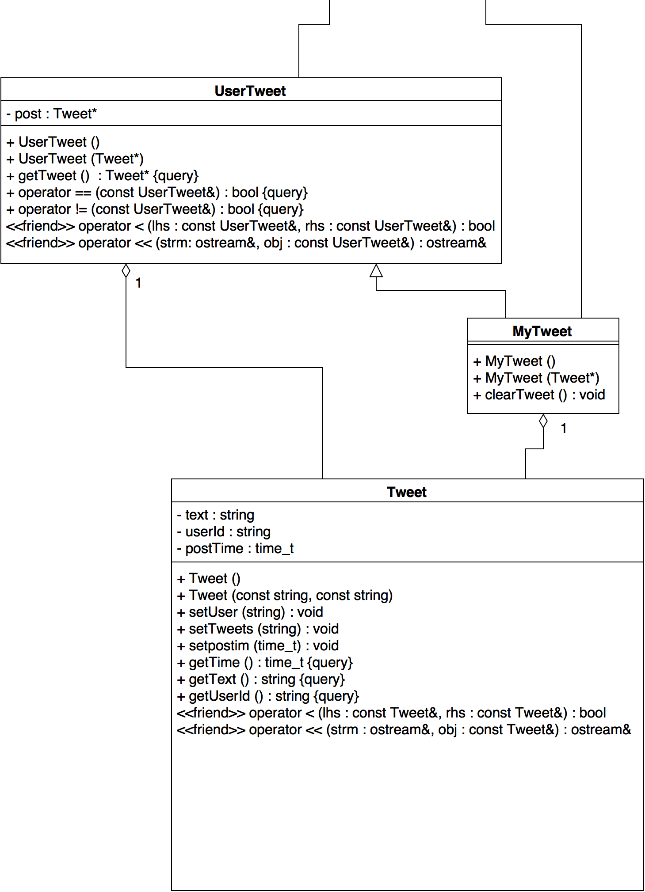
UML

Slide 7

Division of Labor :)
AVL Tree: Patricia, Willis.
Hashtable: Randy.
Main: Jason, Calvin.
User Class: Patricia.
Tweet & TweetContainer Class : Willis.
Server: Willis.
List, Queue: Randy, Willis.

Slide 8

Hash Table
Quadratic Hashing
Used a data container to determine if a spot was empty
Used to Hold User objects

Slide 9
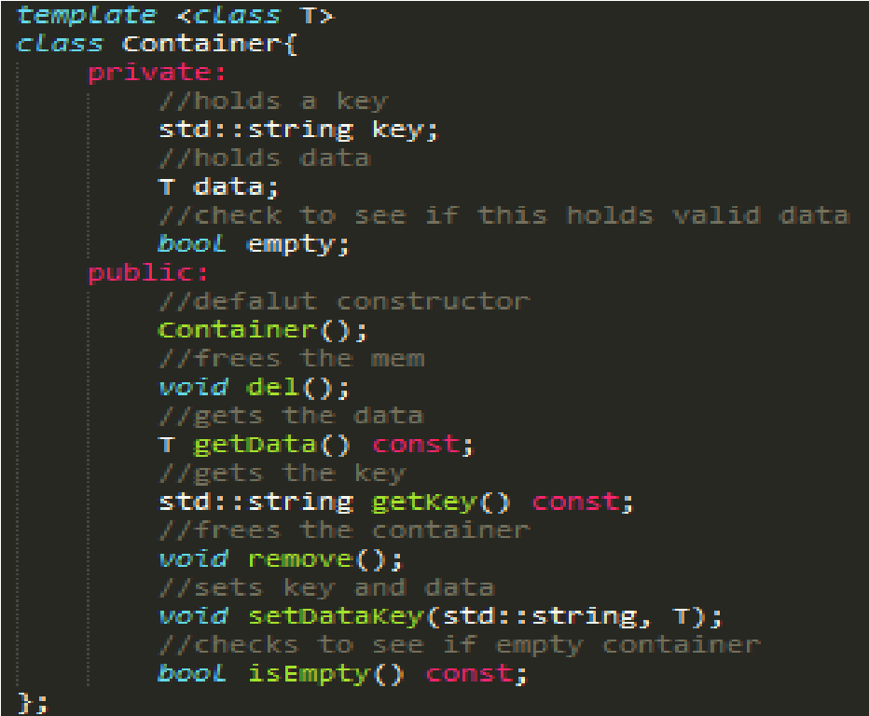
Container
Holds data inserted into the Hashtable
A bool type to check if the container is empty or not
Holds the key as well
Has functions to retrieve data or keys and set data/key pairs

Slide 10
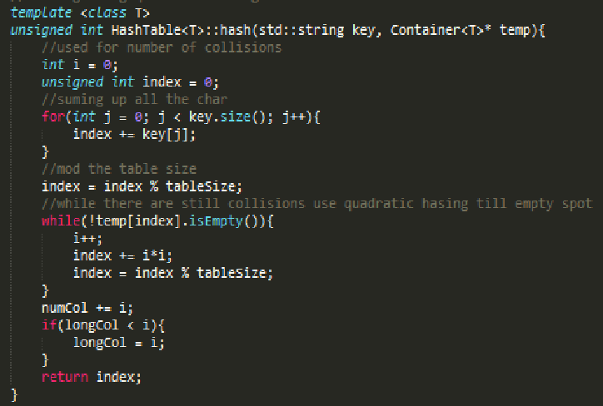
Hash Function (Quadratic Hashing)
Sum up the all the char in the string and get an index by mod table size
If there is a collision, add the number of collisions this key has squared to the index and mod table size
repeat till the index points to a free spot

Slide 11
COLLISION!!!! DDDD:
“22” = ‘2’ + ‘2’ = 50 + 50 = 100
Index = 100 % 53 = 47
“d” = ‘d’ = 100
Index = 100%53 = 47
Index(“22”) == Index(“d”)
DDDDD:
“22”
47
“d”
48
(Index(“d”) + numCollistions^2) % tableSize
this case (47 + 1^2) % 53 = 48

Slide 12
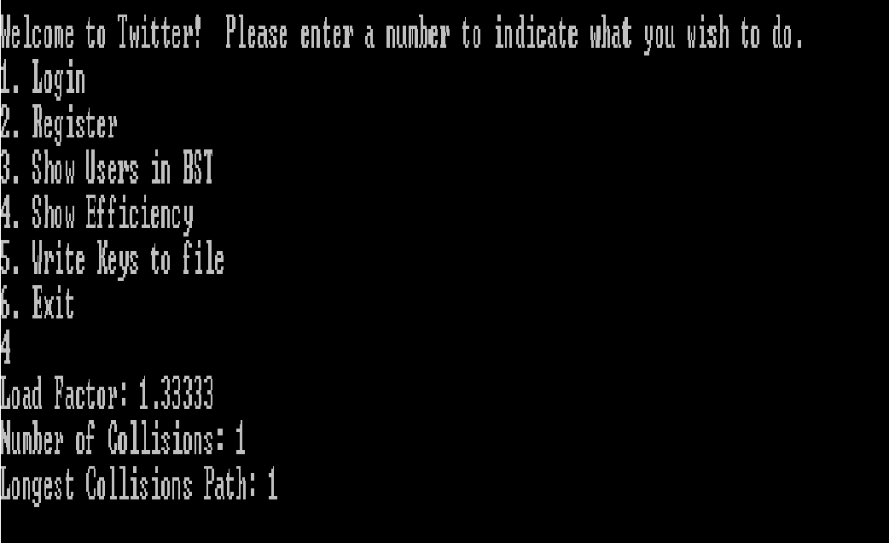
Efficiency
Insertion: O(1)
Increases depending on number of collisions
Deletion: O(1)
Also increases depending on number of collisions
Acquisition: O(1)
As above Increases with Collisions

Slide 13
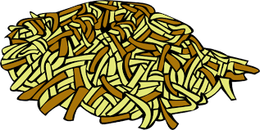
Efficiency
Rating 5/5 HashBrowns :DD
Insertion: O(1)
Increases depending on number of collisions
Deletion: O(1)
Also increases depending on number of collisions
Acquisition: O(1)
As above Increases with Collisions

Slide 14

AVL Tree
Used to hold Tweets and Strings
Self balancing
Since Tweets are compared by time, need AVL to make sure it does not look like a list
Has the option to Stream its data by putting the data in a Queue

Slide 15
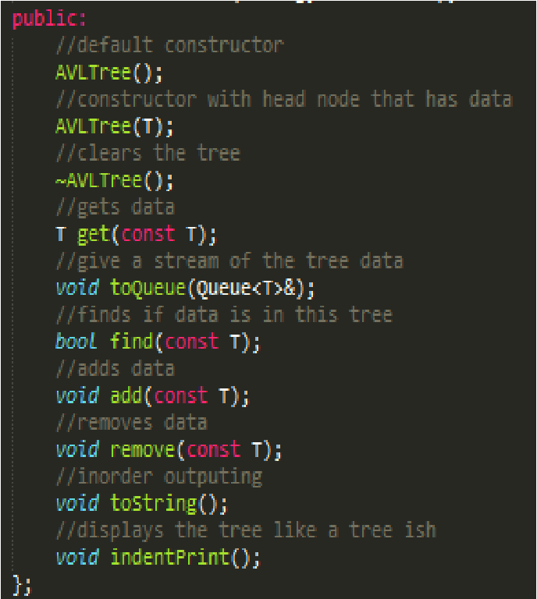
Functionality
Constructors and Destructors
Get the data
Make a Queue to stream the data
Check to see if the BST holds certain Data
Add data
Remove Data
Prints data out in order
Prints the Tree Structure

Slide 16
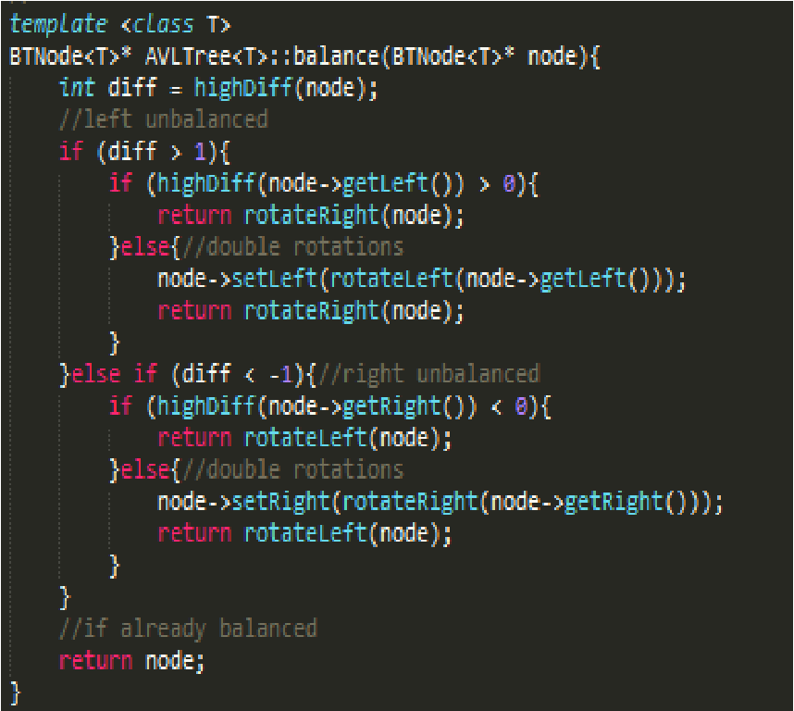
Balancing
Used so the Newsfeed would not look like a list
If the height diff is greater than 1 the left side is unbalanced
If height diff is less than -1 right side is unbalanced
If neither of the above, the node is completely balanced and send the node back to be relinked

Slide 17

Efficiency
Insertion: O(log(n))
A bit more due to rotation and height checks
Deletion: O(log(n))
Same as above a bit more due to rotations and height checks

Slide 18
Efficiency
Insertion: O(log(n))
A bit more due to rotation and height checks
Deletion: O(log(n))
Same as above a bit more due to rotations and height checks
Rating 0 buring Trees :DD

Slide 19
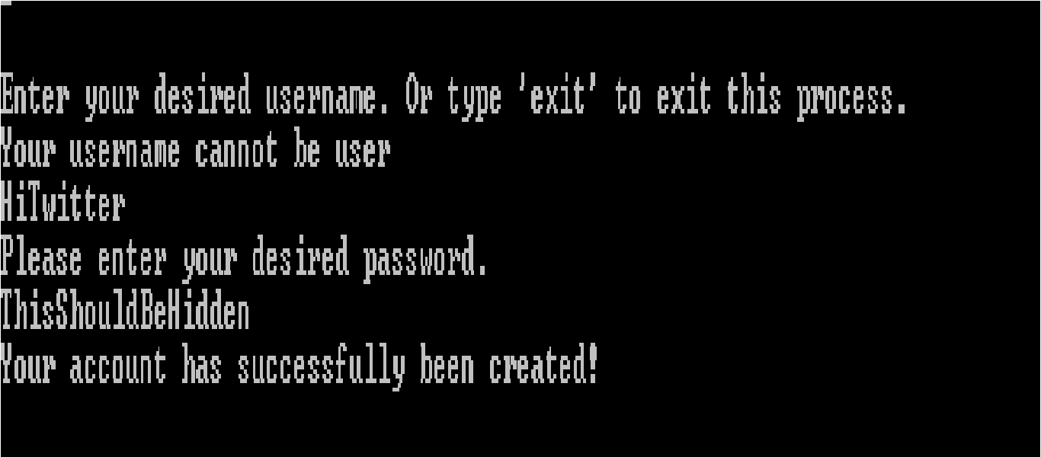
The User Class
Unique Data:
UserName: HiTwitter
Pass: ThisShouldBeHidden
Other Data:
MyTweets
Newsfeed
Followers
Following

Slide 20
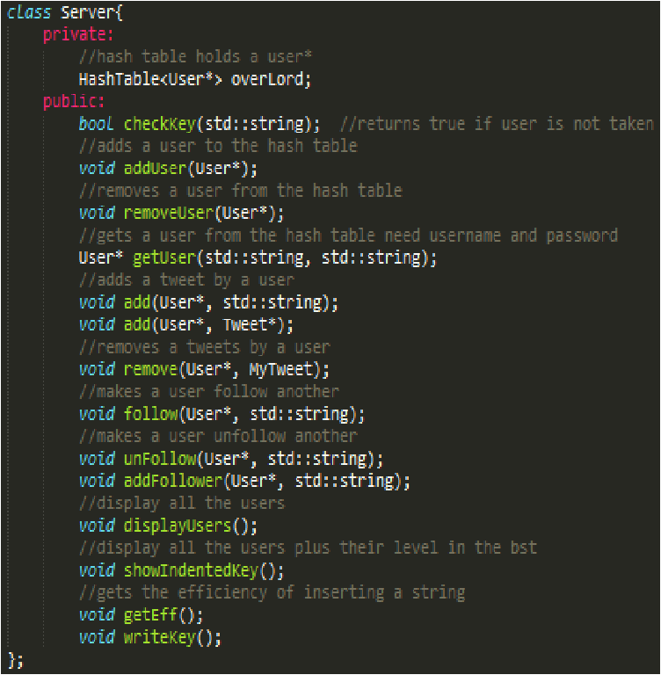
The Server Class (Where the magic happens)
This class contains the Master Hashtable
Class where all the users interact with each other
Basically it is the middle point between main and the Users

Slide 21
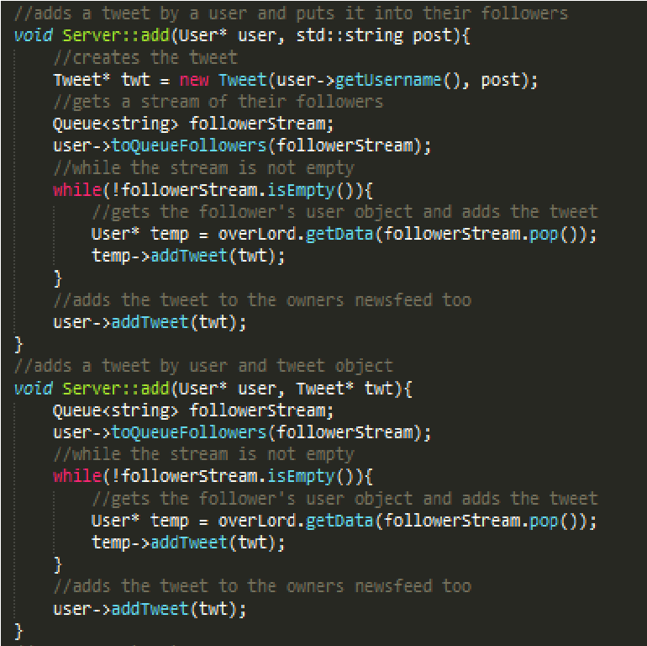
Code Snippet (Server::add)
Get a Queue of your followers
Get their User object from the hash table
Add to their NewsFeed
Repeat till you have no more followers
Add to your NewsFeed

Slide 22
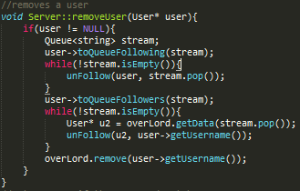
Code Snippet 2 (Server::removeUser)
Make sure the User you are removing exists
Get a stream of everyone you follow and unfollow all of them
Get a stream of everyone who follows you and have them all unfollow you
Remove from hashtable

Slide 23
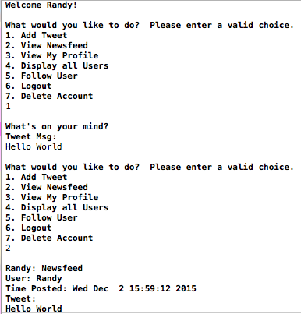
IO and UI
Usernames and passwords are case and space sensitive, as are tweets.
Input validation on all user input selection menus
A User cannot follow itself even if it may appears in the list of users

Slide 24
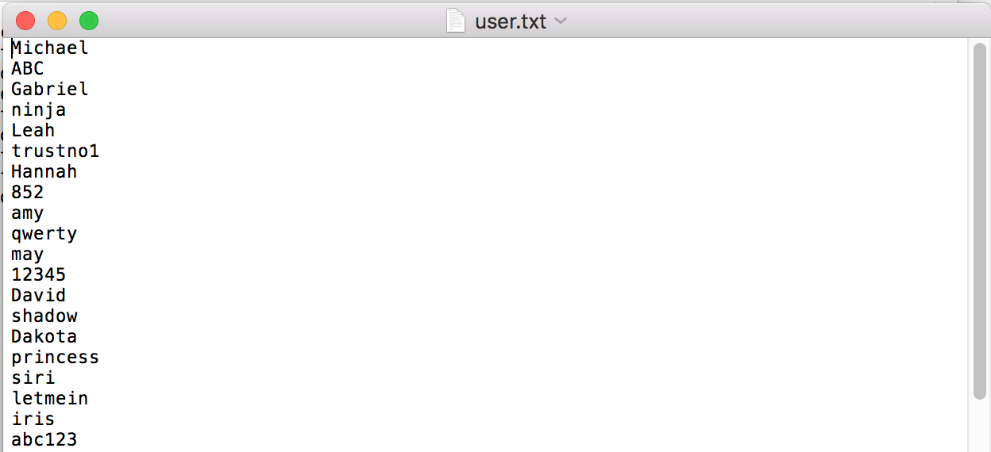
Data Record - Usernames and passwords
Username
Password

Slide 25
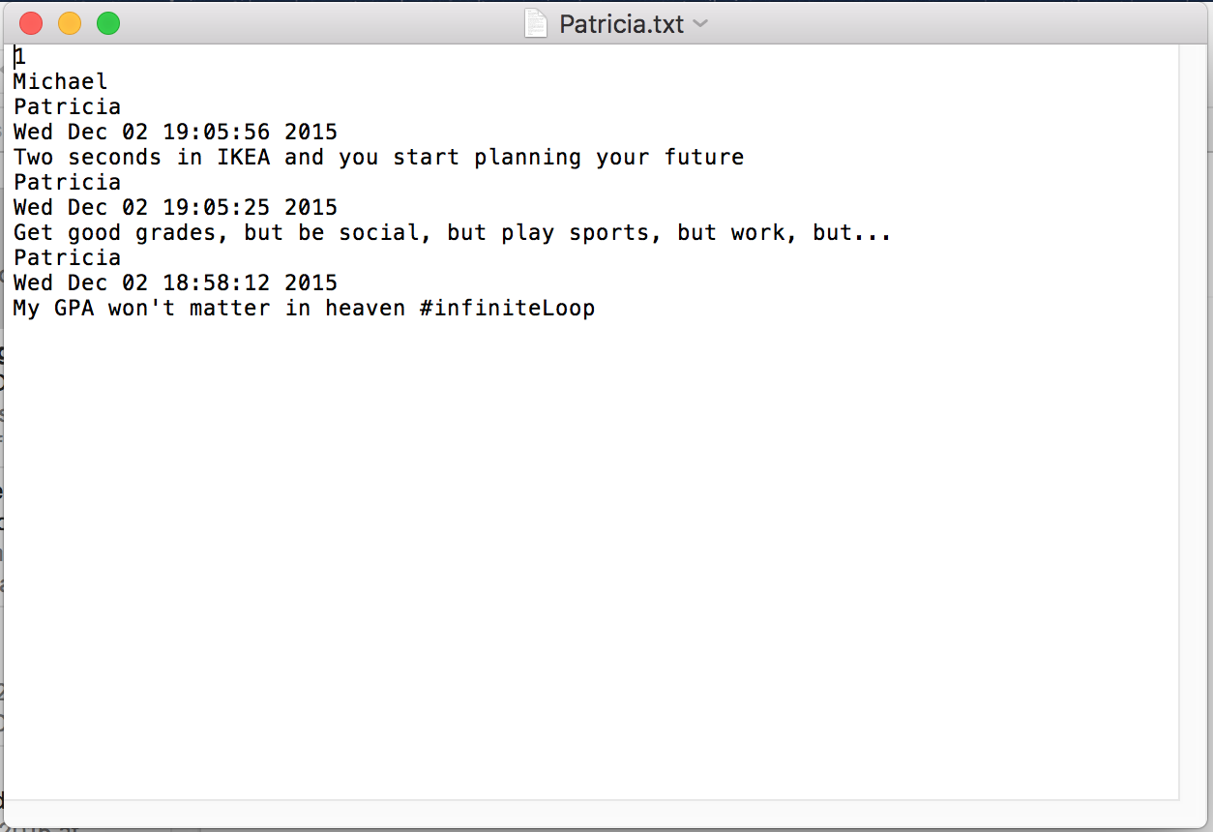
Data Record - A Single User
Number of Followers
Followers
Username
Post time
Tweet

